Slide 1


PSCMR ONLINE LIBRARY
Submitted By
Mr. CH Nagaraju (20KT1A4210)
Ms. S Rani (20KT1A4247)
Mr. S.G.S.V Tarun (21KT5A4203)
Mr. C Jignesh (20KT1A4212)
Under the Esteemed Guidance of
Ms: P.SRI SILPA, M.Tech, (Ph.D.)
Associate Professor.

Slide 2


Contents
Abstract
Introduction
Hardware requirements
Software requirements
Existing system
Proposed system
Results
Conclusion
Thank you
Queries

Slide 3
ABSTRACT
The main objective of PSCMR Online Library is to developing a computerized system to maintain all the daily work of the library. It has two sides
User side (students /Admin ).
Student side
Only registered users can get every facility of this website.
They can log in to their account and see their personal information and modify them.
They can search for a book by the name or search it in a particular department.
After the admin approve it, they can see the issue and return date beside the book name.

Slide 4

ABSTRACT (CONTD.......)
An automatic timer will set up on the user’s id. It’ll show how much time left until the return date.
If they need more time, they can send a message to the admin.
Also, there is a public comment section where registered users can comment on their suggestions and can ask questions.
On the other hand, ADMIN can:
see all the student information.
add new books & delete a book from the list.
send a notification to students before their return date and they can also communicate through message.

Slide 5

INTRODUCTION
1.1 HTML:
The Hypertext Markup Language or HTML is the standard markup language for documents designed to be displayed in a web browser. It can be assisted by technologies such as Cascading Style Sheets (CSS) and scripting languages such as JavaScript.

Slide 6
INTRODUCTION
1.2 CSS:
Cascading Style Sheets (CSS) is a style sheet language used for describing the presentation of a document written in a markup language such as HTML, CSS is a cornerstone technology of the World Wide Web, alongside HTML and JavaScript.
CSS is designed to enable the separation of presentation and content, including layout, colors and fonts.
CONTD......

Slide 7
CONTD....
1.3 JAVASCRIPT:
JavaScript often abbreviated JS, is a programming language that is one of the core technologies of the World Wide Web, alongside HTML and CSS. Over 97% of websites use JavaScript on the client side for webpage behavior, often incorporating third-party libraries. All major web browsers have a dedicated JavaScript Engine to execute the code on users' devices.
JavaScript is a high-level, often just-in-time compiled language that conforms to the ECMAScript standard. It has dynamic typing, prototype-based object-orientation, and first-class functions.
INTRODUCTION​

Slide 8
1.4 php
INTRODUCTION CONT........
The term PHP is an acronym for PHP: Hypertext Pre-processor. PHP is a server-side scripting language designed specifically for web development. It is open-source which means it is free to download and use. It is very simple to learn and use. The files have the extension “.php”.
Rasmus Lerdorf inspired the first version of PHP and participating in the later versions. It is an interpreted language and it does not require a compiler.

Slide 9
HARDWARE REQUIREMENTS
 | Windows Requirements | Mac Requirements | Linux Requirements
Operating System | Windows 8 or later | macOS Sierra 10.12 or later | 64-bit buntu14.04+,Debian 8+,openSUSE 13.3+, or Fedora Linux 24+
Processor | Intel Pentium 4 or later | Intel | Intel Pentium 4 or later
Memory | 2 GB minimum, 4 GB recommended | 2 GB minimum, 4 GB recommended | 2 GB minimum, 4 GB recommended
Screen Resolution | 1280x1024 or larger | 1280x1024 or larger | 1280x1024 or larger
Application Window size | 1024x680 or larger | 1024x680 or larger | 1024x680 or larger
Internet Connection | Required | Required | Required

Slide 10
SOFTWARE REQURIMENTS
2.1 SUBLIME TEXT:
Sublime Text is a shareware cross-platform source code editor. It natively supports many programming languages and markup languages. Users can expand its functionality with plugins, typically community-built and maintained under free-software licenses. To facilitate plugins, Sublime Text features a Python API.

Slide 11
2.2 CHROME:
Google Chrome is a cross-platform web browser developed by Google. It was first released in 2008 for Microsoft Windows, built with free software components from Apple Web kit and Mozilla Firefox. It was later ported to Linux, macOS, and Android, and Android, where it is the default browser. The browser is also the main component of Chrome OS, where it serves as the platform for web applications.

Slide 12
2.3XAMPP:
XAMPP is a free and open-source cross-platform web server solution stack package developed by Apache Friends,consisting mainly of the Apache HTTP Server, MariaDB database, and interpreters for scripts written in the PHP and Perl programming languages.Since most actual web server deployments use the same components as XAMPP, it makes transitioning from a local test server to a live server possible.

Slide 13

EXISTING SYSTEM
When a library is contained in a building that’s open to the students, access to the library’s resources is restricted by the amount of time the library can be physically open.college libraries have operating hours; if an individual arrives too late, she won’t be able to access the library’s resources. People are restricted too by the amount of time they can spend with a resource, since each must be returned to the library within a set period of time.

Slide 14

PROPOSED SYSTEM
1. Simple & Easy to Use
2. Increased Library Engagement
3. Efficient Cloud Data Management
4. Highly Secure, Scalable & Reliable
6. Dynamic Reports
9. Fully Customizable

Slide 15
RESULTS

Slide 16
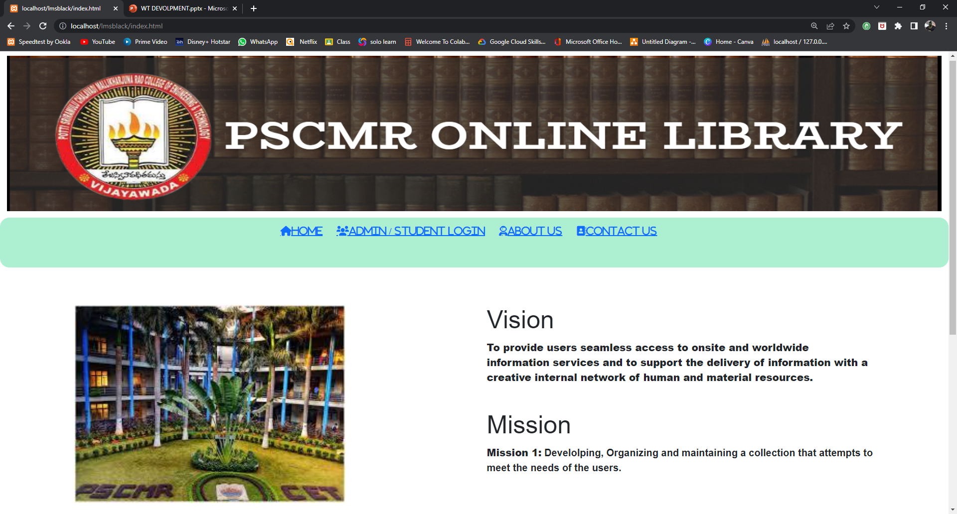
HOMEPAGE

Slide 17
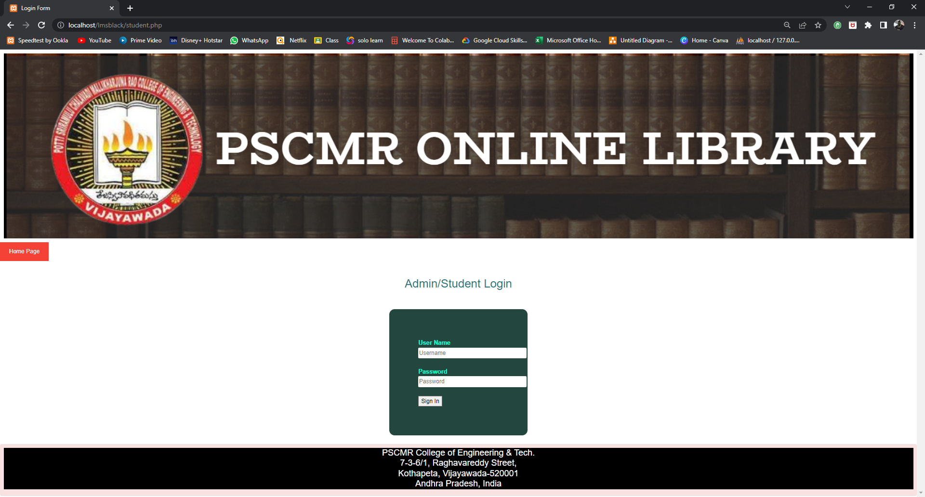
ADMIN/STUDENT LOGIN PAGE

Slide 18
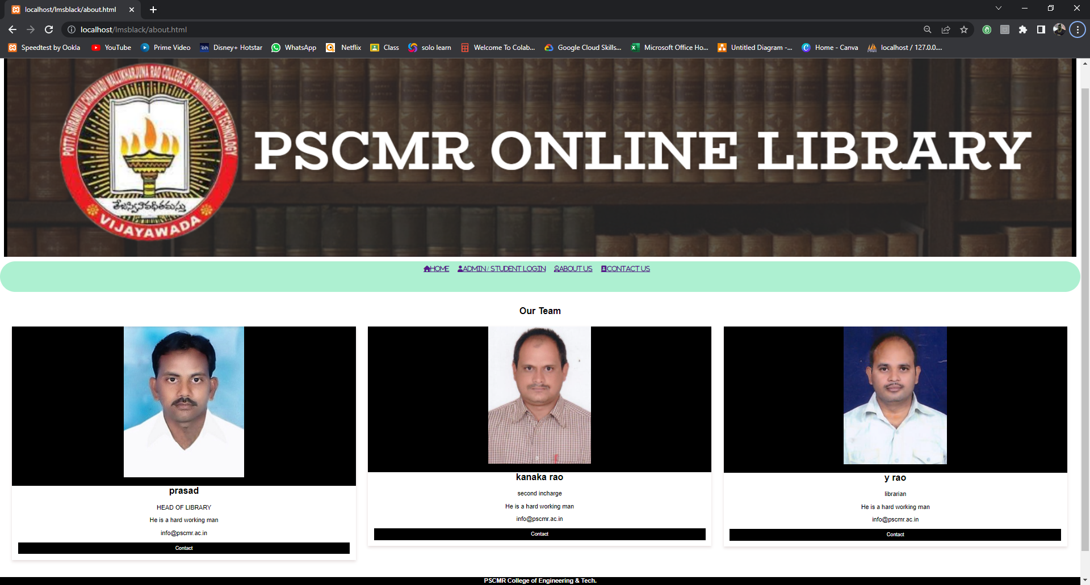
ABOUT US

Slide 19
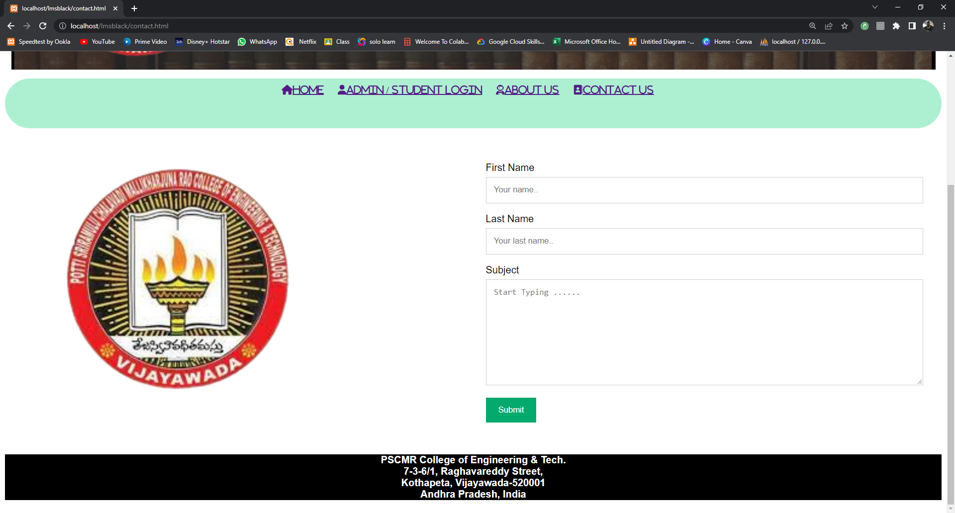
CONTACT US

Slide 20

ADMIN SIDE PAGE

Slide 21
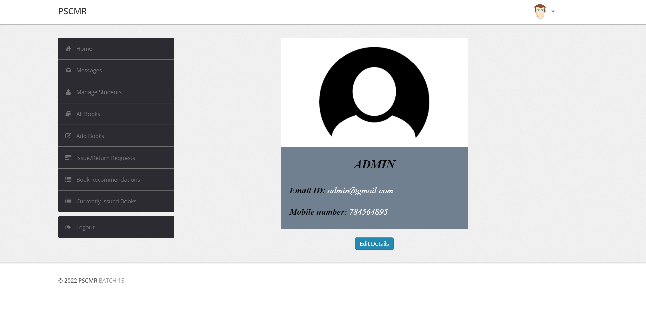
ADMIN DETAILS

Slide 22
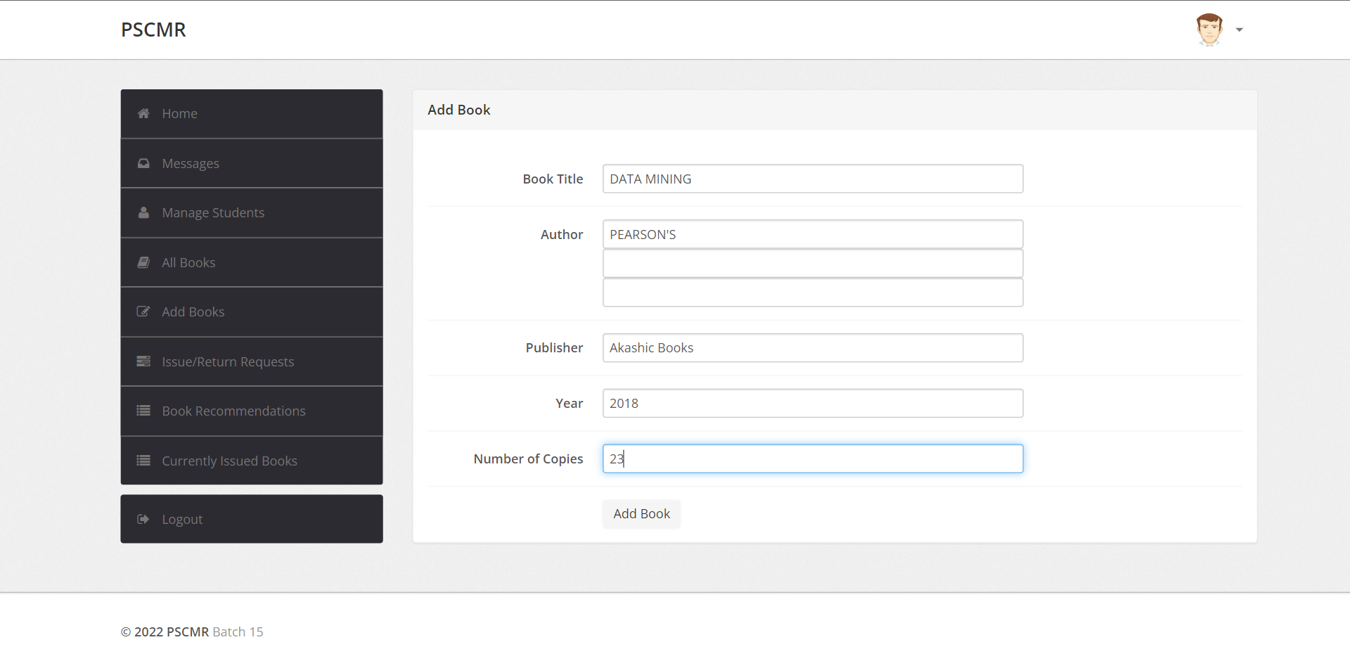
ADD BOOK

Slide 23
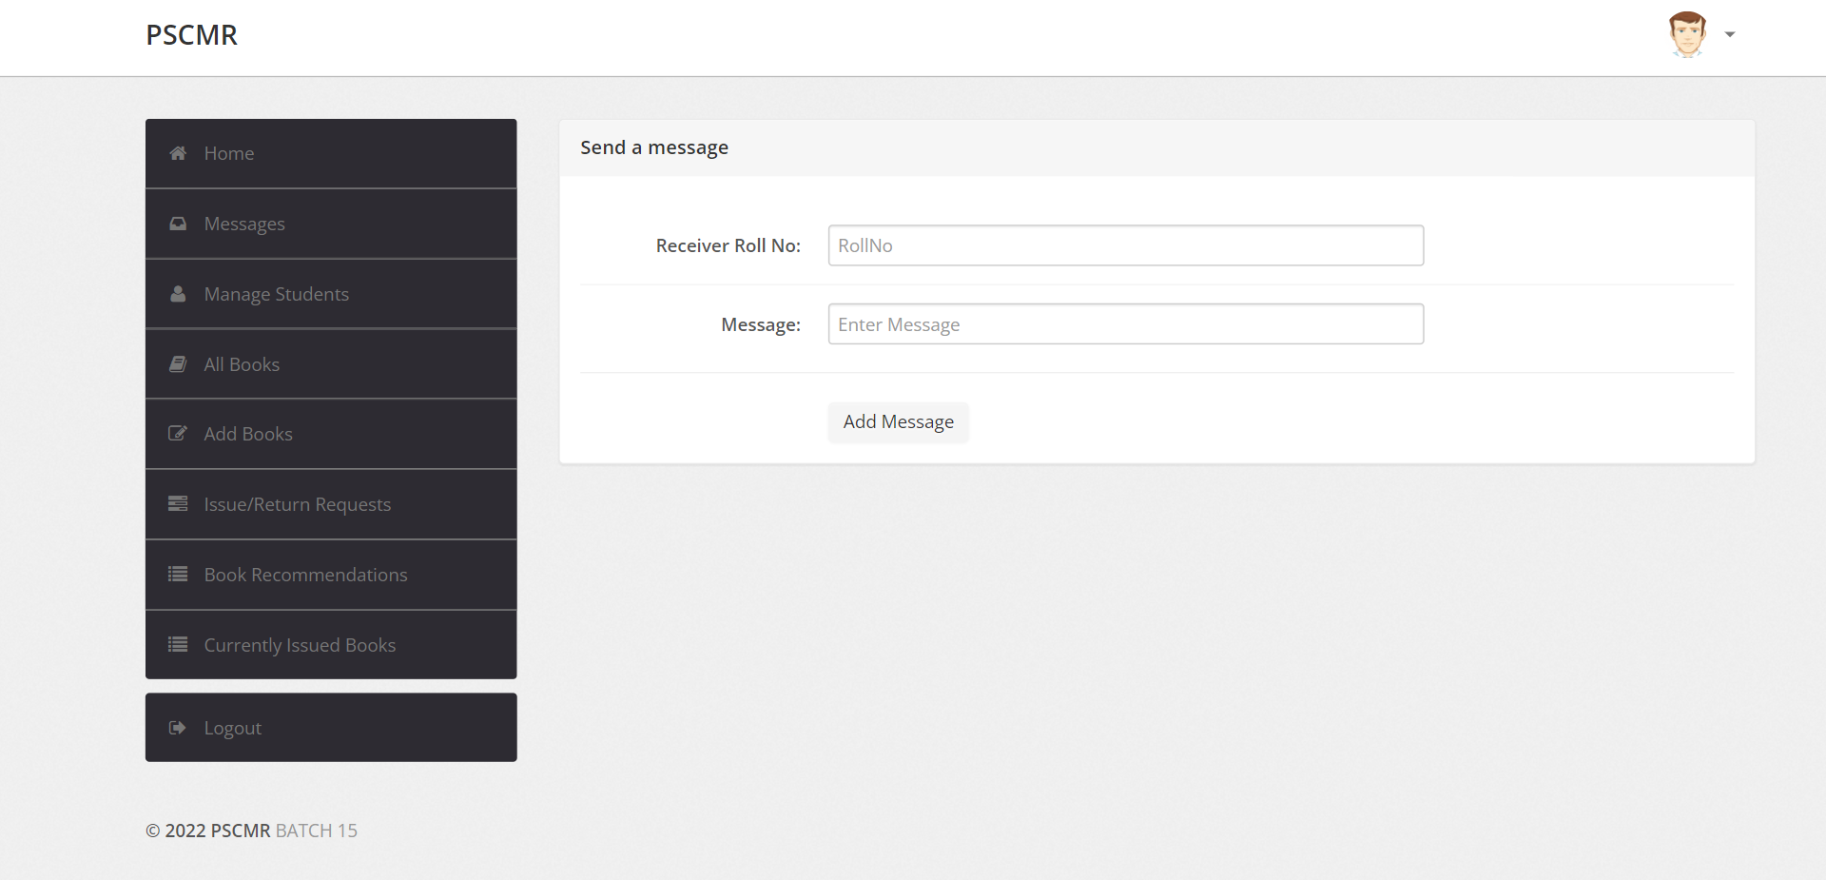
MESSAGES

Slide 24
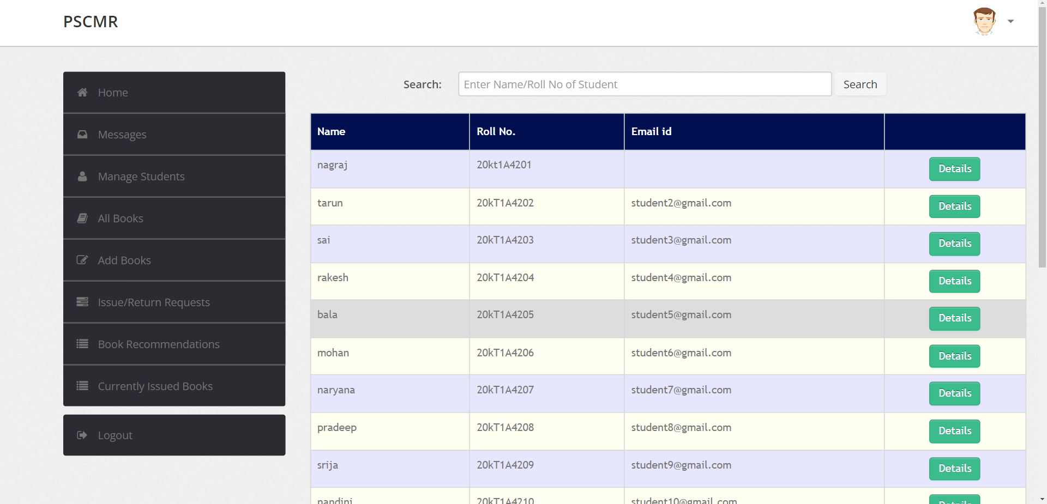
MANAGE STUDENTS

Slide 25
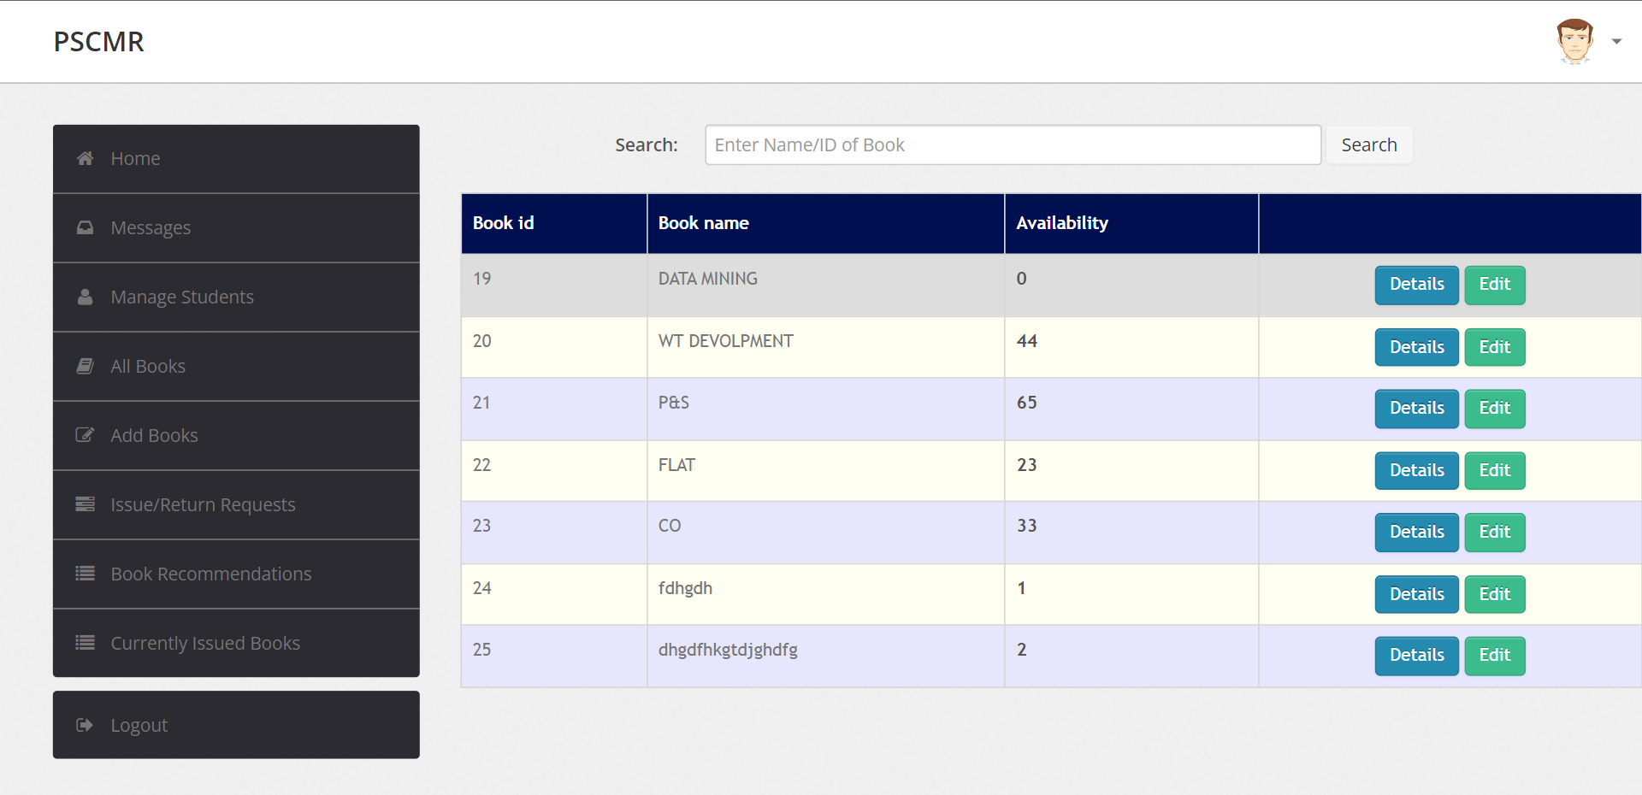
BOOKS

Slide 26
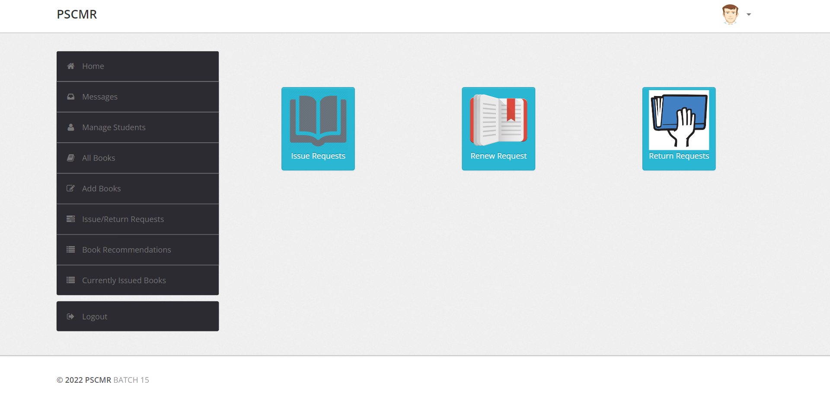
ISSUE/RETURN REQUEST

Slide 27
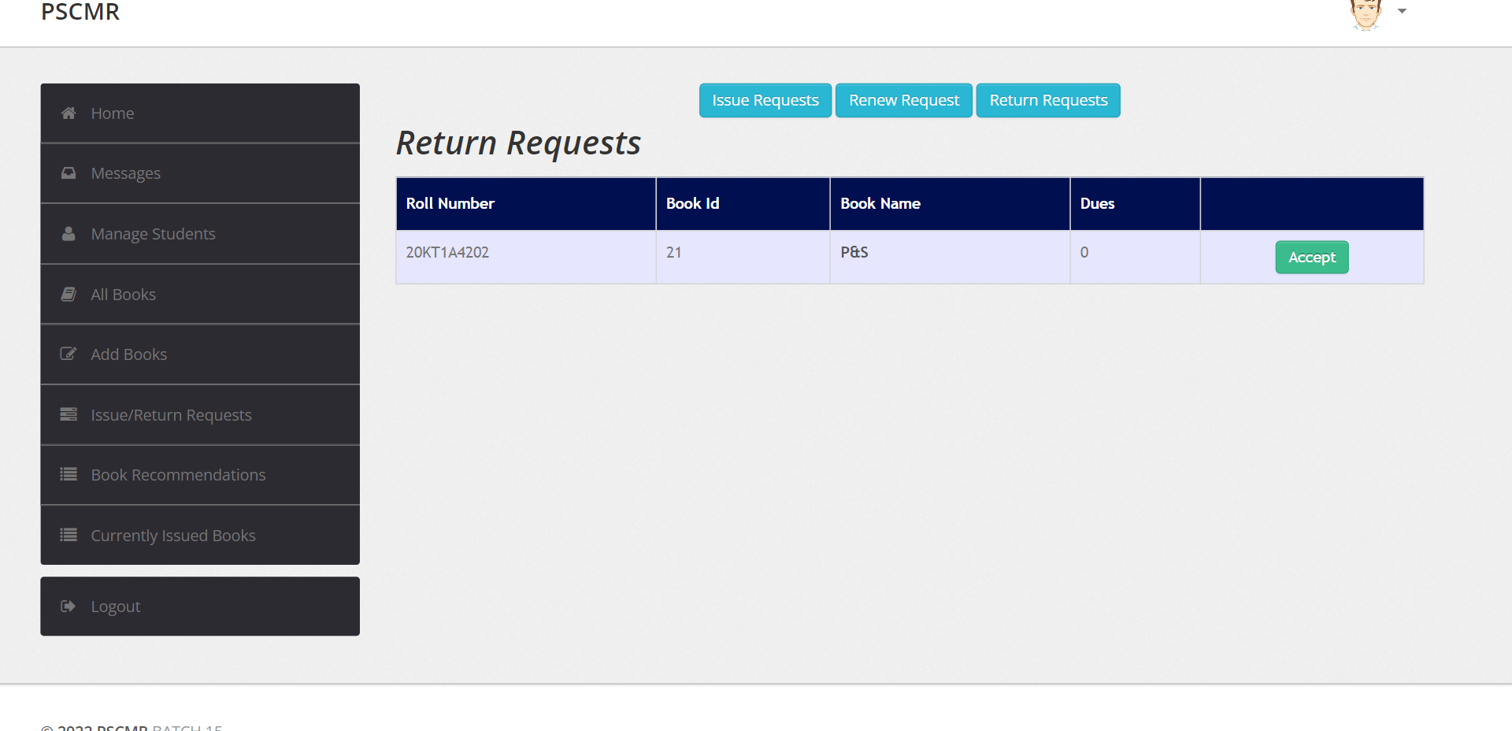
RETURN REQUEST

Slide 28
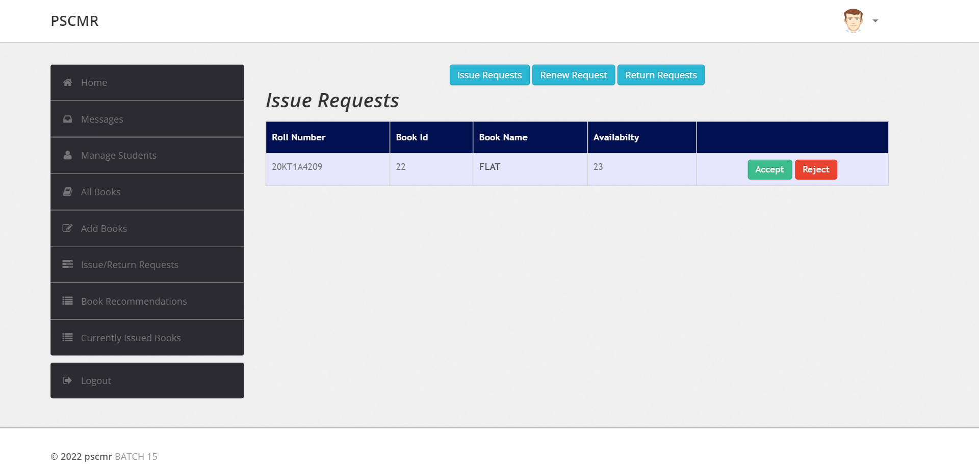
ISSUE REQUESTS

Slide 29
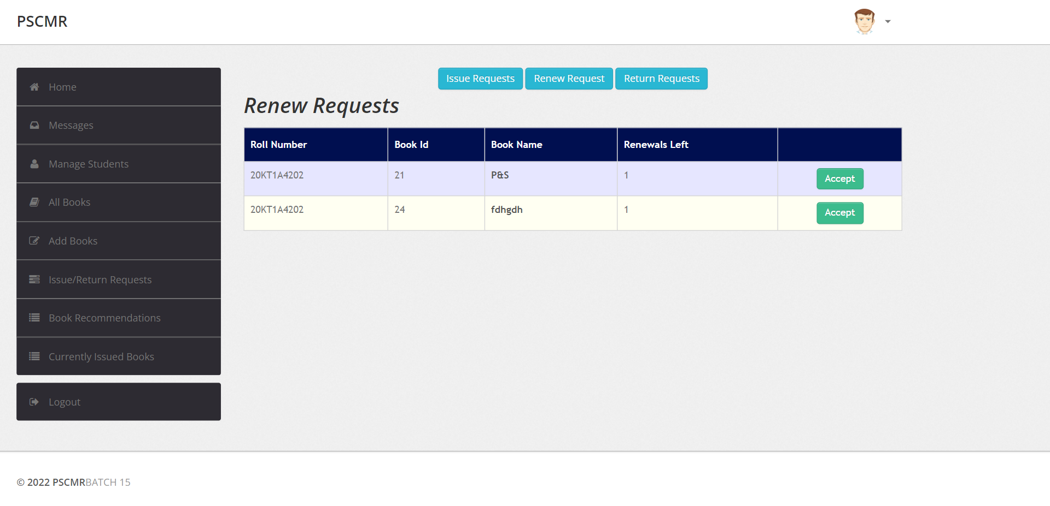
RENEW REQUESTS

Slide 30
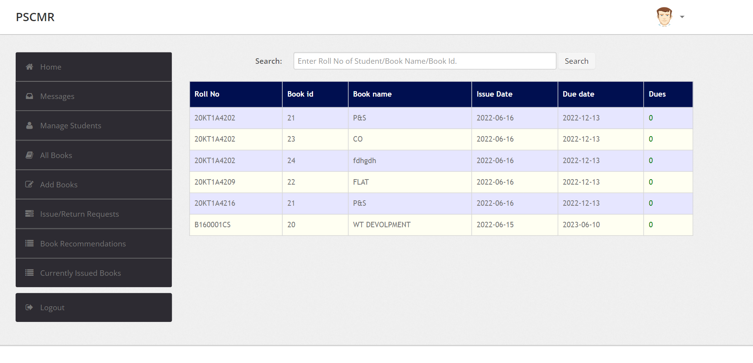
CURRENTLY ISSUED BOOKS

Slide 31

STUDENT SIDE PAGE

Slide 32
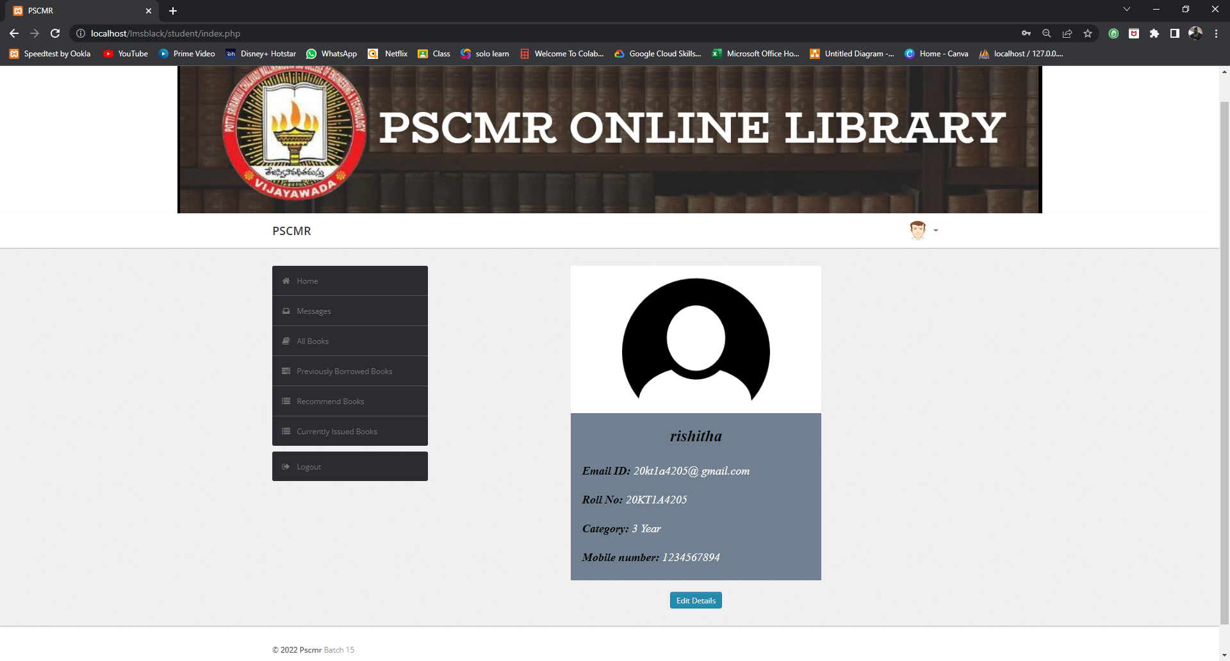
Student HomePage

Slide 33
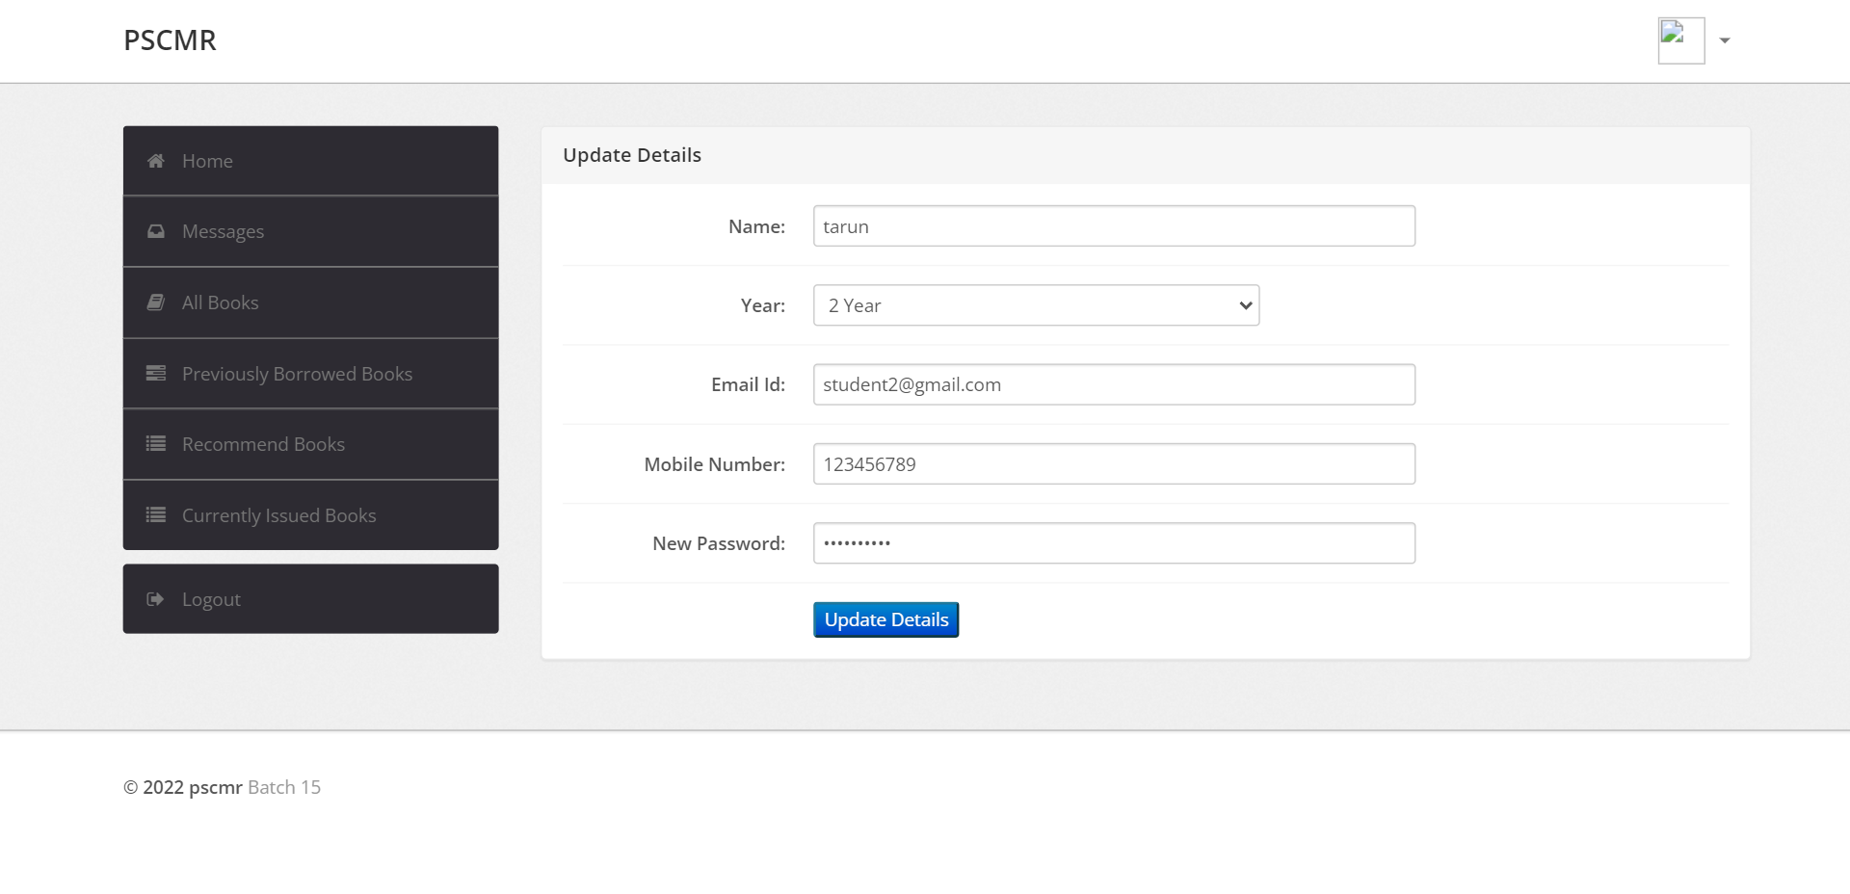
STUDENT UPDATE DETAILS

Slide 34
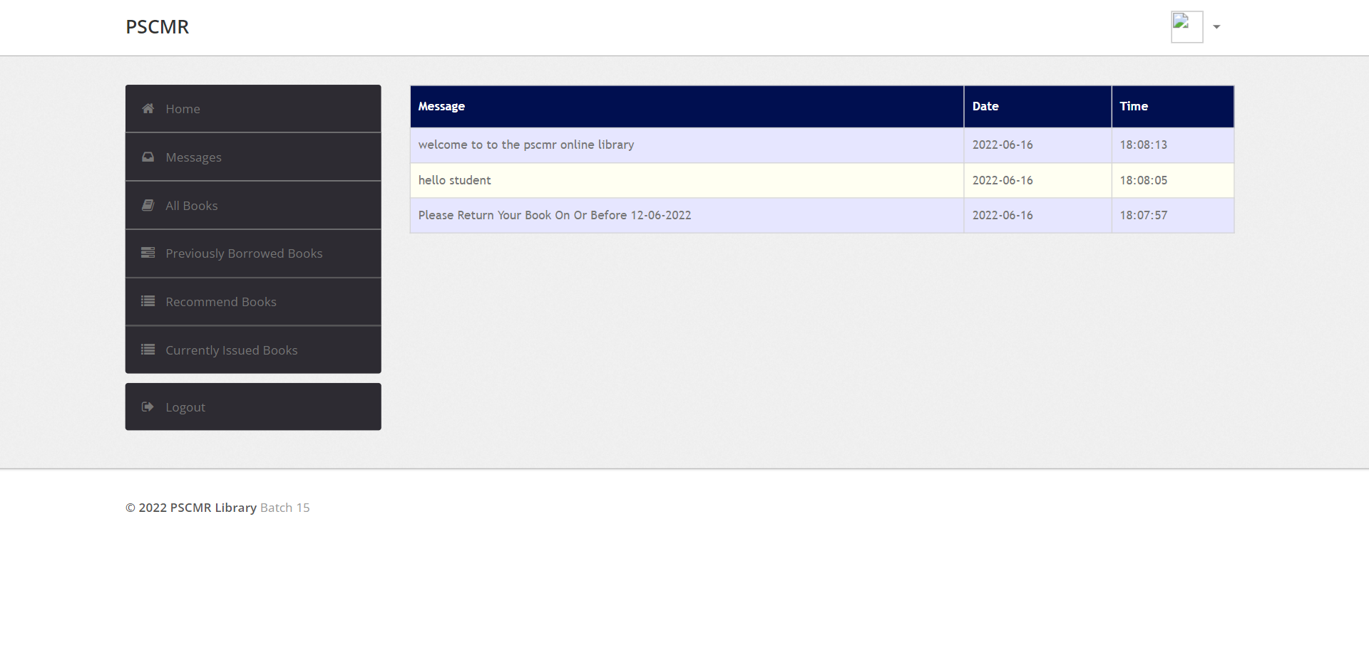
MESSAGES

Slide 35
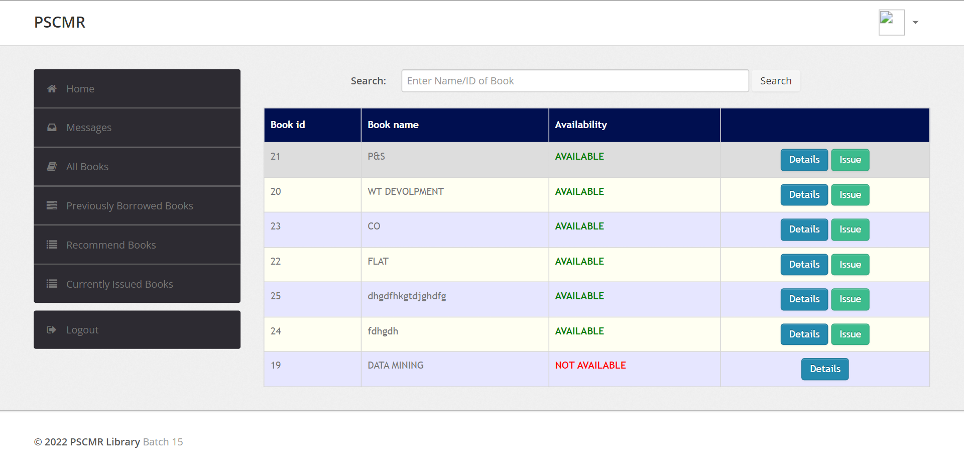
BOOKS LIST

Slide 36

PHP CONNECTION

Slide 37
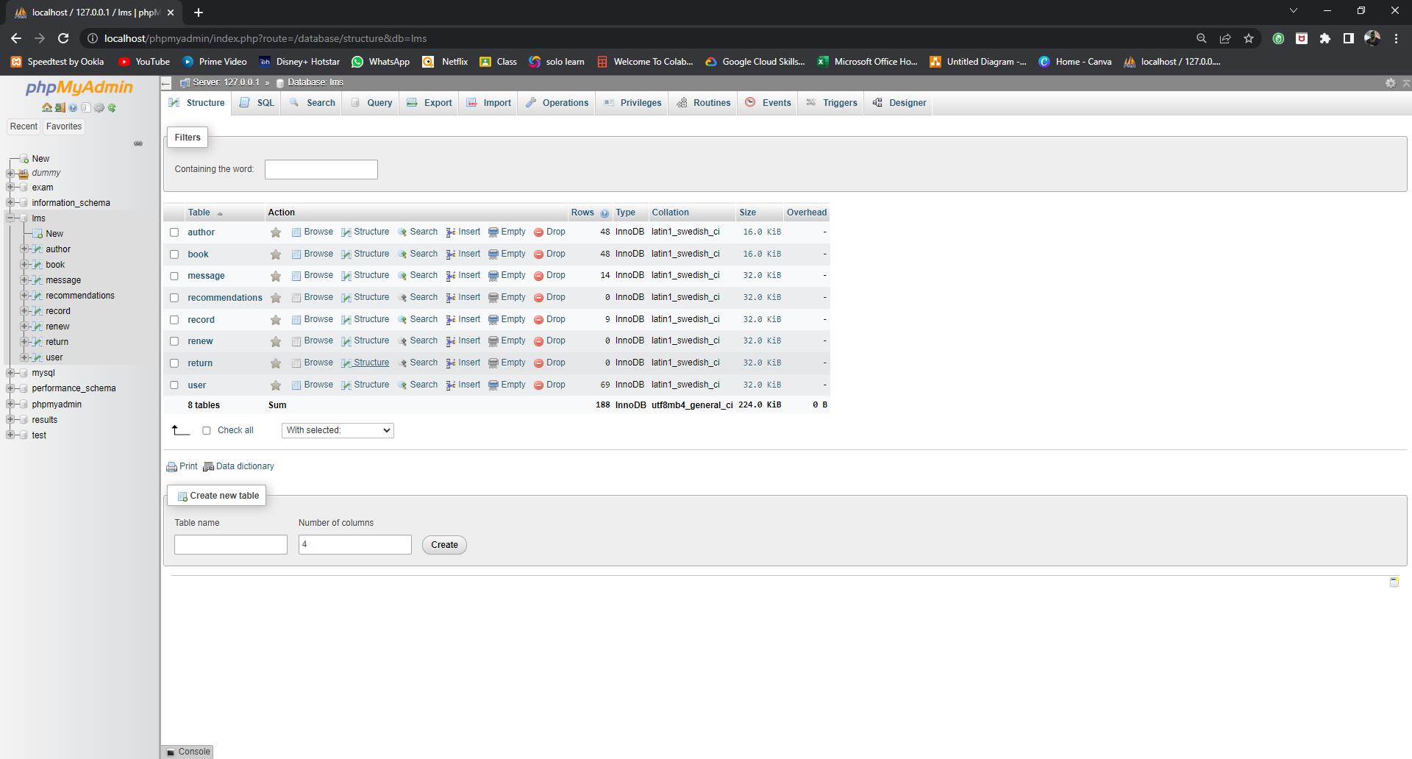
List Of Tables

Slide 38
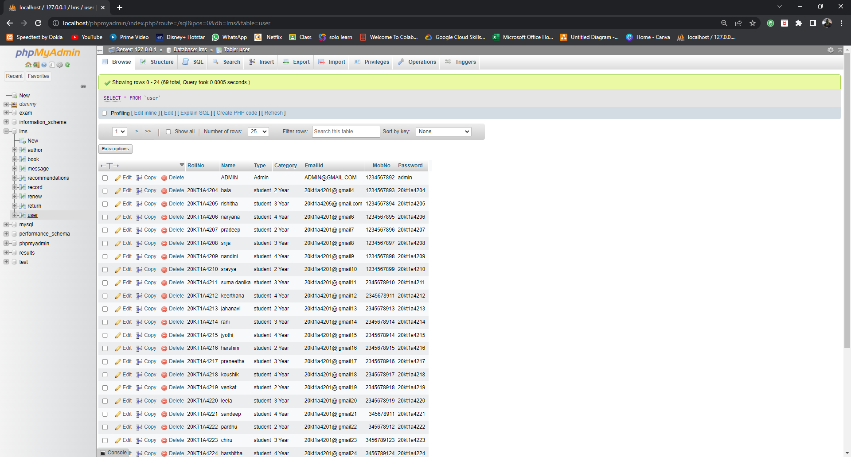
User Database

Slide 39
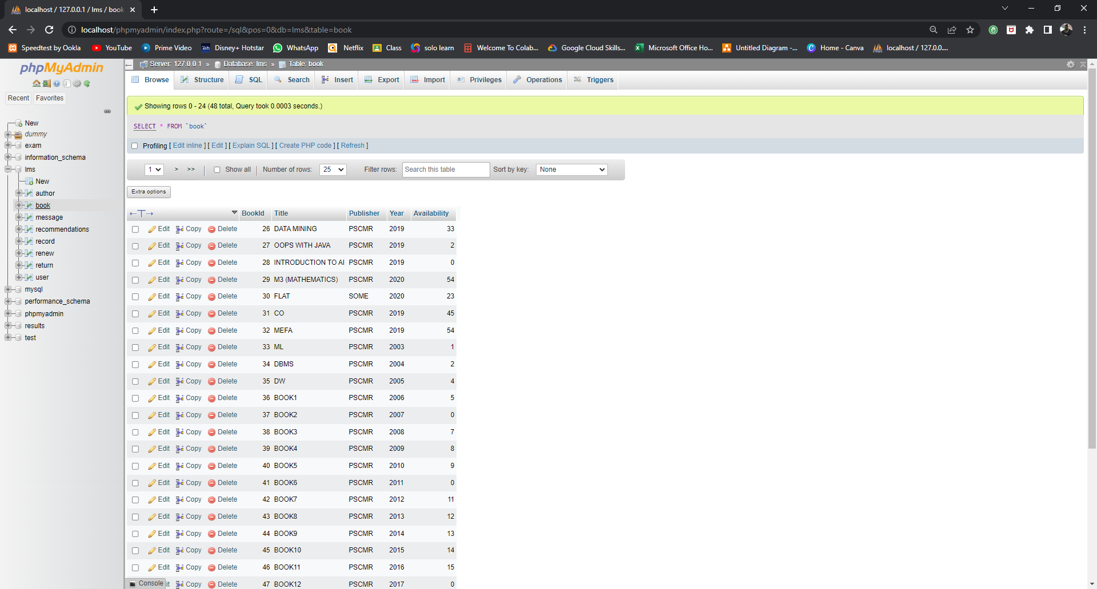
Books Database

Slide 40
CONCLUSION
The project PSCMR ONLINE LIBRARY is for computerizing the working in a library
The software takes all requirements of an library and is capable to provide easy and effective storage of information related to books & user.
Our website provides a computerized version of library management system which will benefit the students as well as the staff of the library.
It makes entire process online where student can search books, staff can generate reports and do book transactions. It also has a facility for student login where student can login and can see status of books issued as well request for book or give some suggestions. It has a facility of teacher’s login where teachers can add lectures notes and also give necessary suggestion to library and also add info about workshops or events happening in our college or nearby college in the online notice board.

Slide 41

THANK YOU

Slide 42


QUERIES

